Slide 1

Bapatla Engineering College: Bapatla – 522102
(Autonomous)
Department of Computer Science and Engineering
Classification of AI Images and Real Images using Deep Learning
Presented by
N.Lakshmi Prathyusha [Y21ACS521]
M.Brahmaji[Y21ACS509] P.Sai Vani[Y21ACS533]
M.S.S.Rahul Gupta[Y21ACS498]
Batch No – B10
Under the Guidance of
Naga Chandra Sekhar Sure, _{M.Tech.}
_{Assistant Professor}

Slide 2
Agenda
2
Abstract
Scope of the Project
Existing System
Proposed System
Implementation steps
Analysis of the Result(s)
Hardware and Software Requirements
Conclusion
Future Scope
References

Slide 3
3
Abstract
As AI technology improves, it is becoming harder to tell the difference between real and AI-generated images, especially in media, advertising, and security. To solve this problem, we have developed an image classification model using TensorFlow, a T4 GPU, and the CIFAKE dataset for training and testing. Our model is based on ResNet50, a powerful deep learning architecture known for accurately analyzing images. Early results show that our model can effectively separate real images from AI-generated ones. This work helps in ensuring image authenticity and faces the challenges posed by fake content in today’s digital world.

Slide 4
Scope of the project
4
Problem Statement
With the advancement of AI-generated imagery, distinguishing between real and computer-generated images has become increasingly challenging. These AI-generated images pose risks in various domains, including cybersecurity, digital forensics, and media authenticity verification. The inability to accurately classify images can lead to misinformation, identity fraud, and unauthorized system access.
Objective
The primary goal of this project is to develop an efficient image classification system that accurately differentiates between real and AI-generated images.

Slide 5
Target Users
Media platforms
Digital forensics
Security agencies
Advertising firms
Applications
Media
Security
Digital forensics
AI ethics

Slide 6
Existing System
Convolutional Neural Networks (CNNs) have been widely used for image classification tasks, including distinguishing between AI-generated (deepfake) and real images.
These models utilize layers of convolutional filters to detect and learn patterns from images, making them highly effective for visual recognition tasks.
Challenges
CNN model applicable only for the small patterns and it is hard to learn complex patterns.
Fails to capture deeper hierarchical features.
CNN model overfit when applied to large datasets with out pre-trained components.
While dealing with highly complex images might provide less accurate results.

Slide 7
Proposed System
7
ResNet50 is a deep convolutional neural network (CNN) architecture that is commonly used for image classification tasks.
Proposed Model:-

Slide 8
8
It is based on the Residual Networks (ResNet) architecture.
ResNet50 has 50 layers and is known for solving the problem of vanishing gradients in very deep networks, allowing the model to effectively train much deeper networks.
Advantages over existing system
High accuracy in image classification tasks due to deep architecture.
Efficient training with less risk of overfitting, especially when using techniques like data augmentation and dropout.
Well-suited for tasks requiring the classification of complex images, like differentiating AI-generated images from real ones

Slide 9
Implementation Steps
Collect Dataset: Gather a data set of real and AI-generated images.
Preprocess Data: Resize and clean the images so they are ready for the model.
Split Data: Divide the images into training, evaluation and testing sets.
Build Model: Use a deep learning model ResNet50 for classification.
Train Model: Train the model using the training images.
Test Model: Testing the model performs on new, unseen images.
Optimize: Improve the model by adjusting settings to reduce overfitting and increase accuracy.
Evaluate Results: Show the final accuracy, confusion matrix, and examples of predictions.

Slide 10
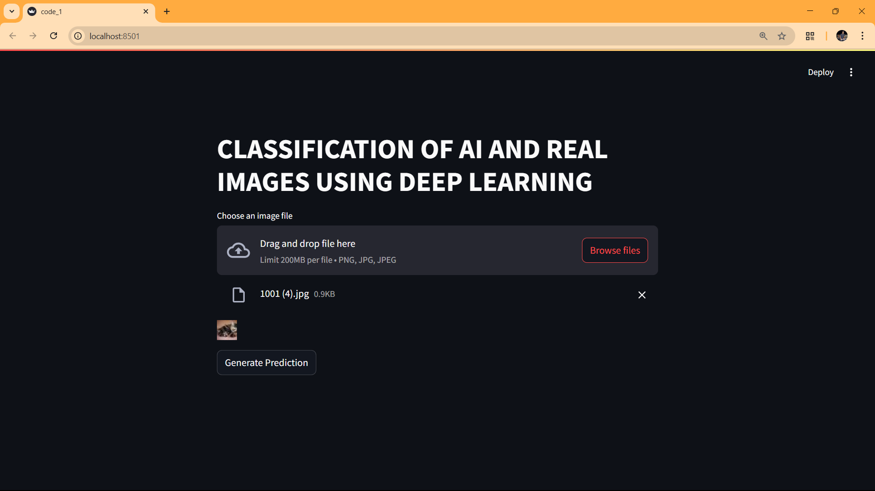
Inputs and Outputs of the project
Inputs of the Project
A collection of images, some real and some created by AI.

Slide 11
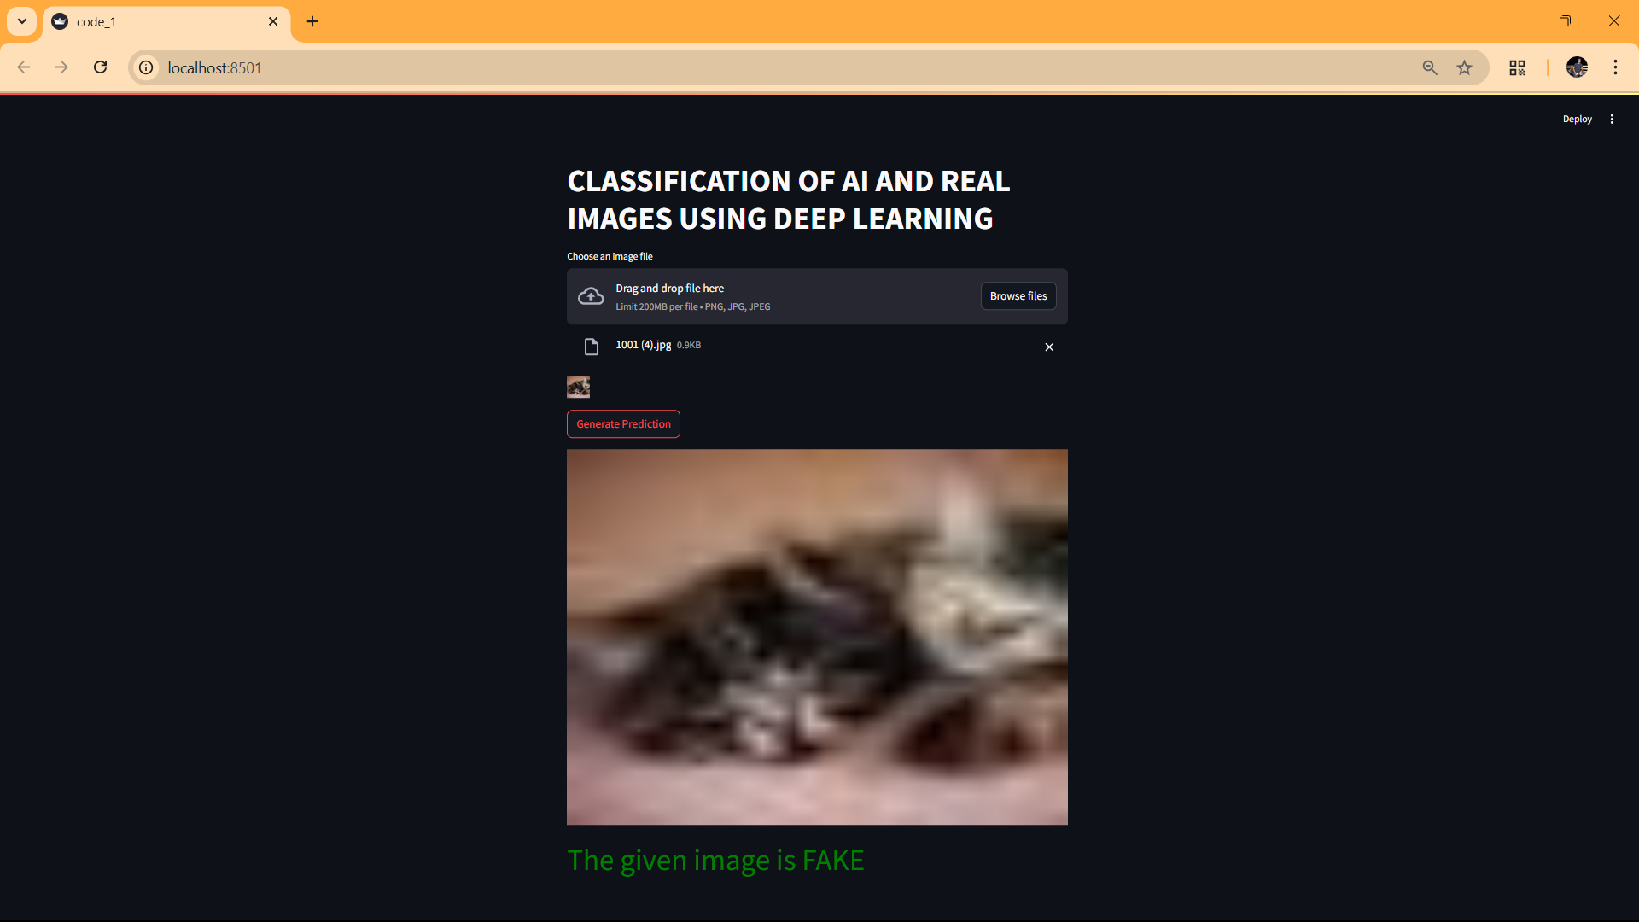
Outputs of the Project
The model predicts whether a given image is real or AI-generated

Slide 12
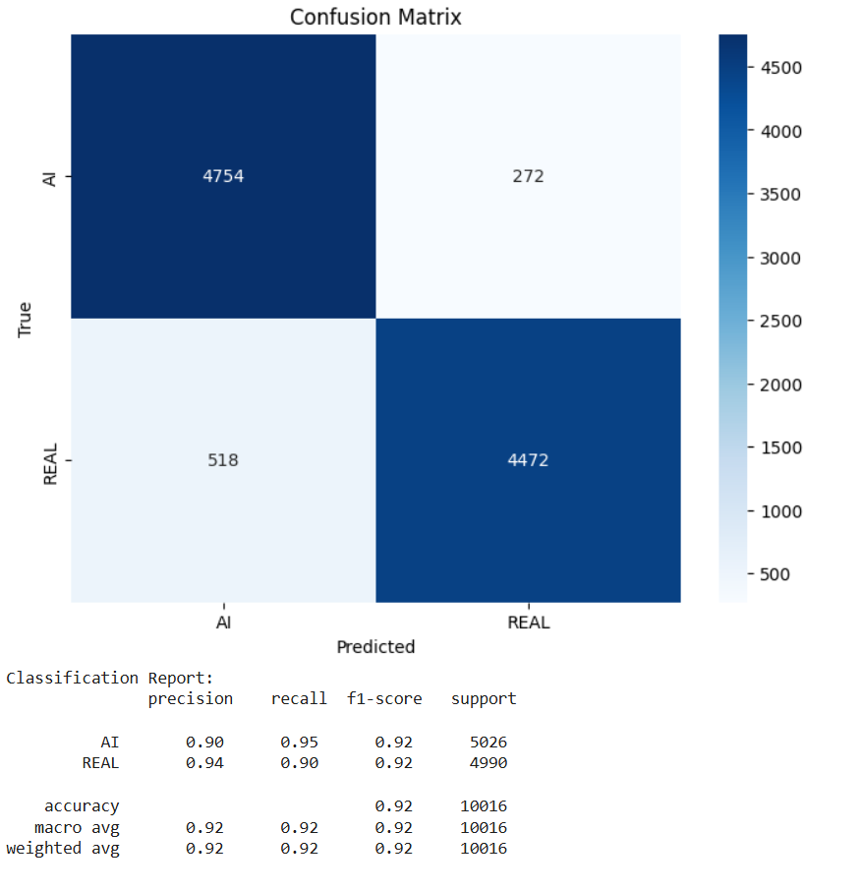
Analysis of the Results
Accuracy of the Model :
The model achieved around 94.2% accuracy, which means it correctly classified most of the images as real or AI-generated
Confusion Matrix :

Slide 13
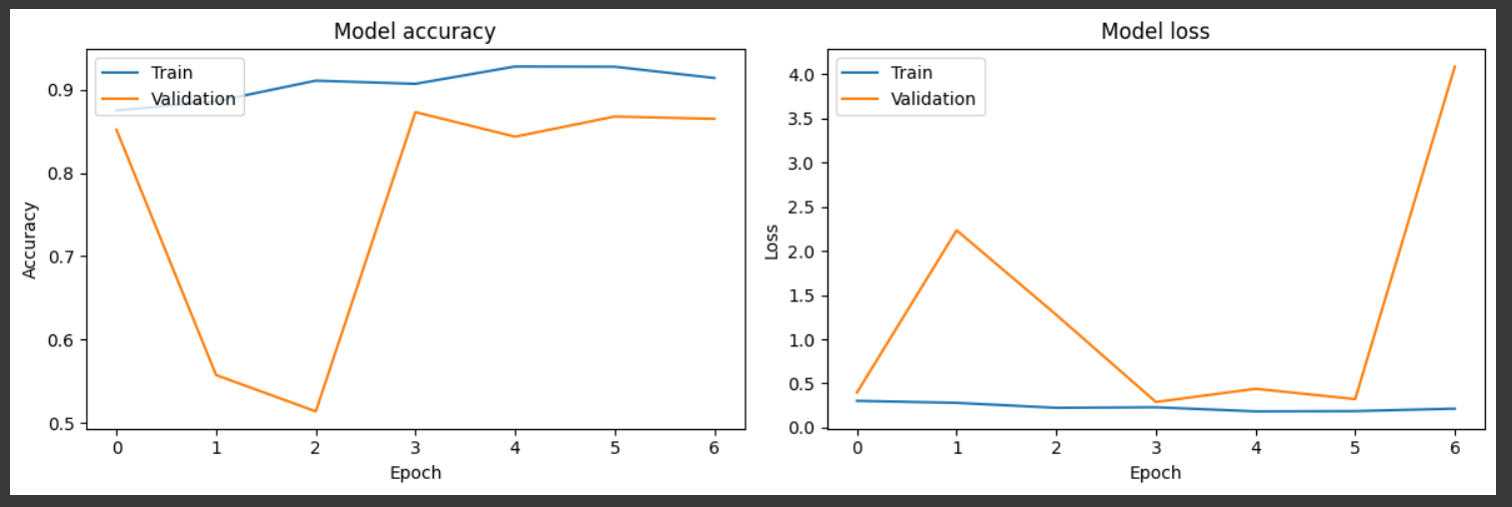
Classification Report :
Visual Results:
Graphs showed training and validation accuracy improving.

Slide 14
Hardware Requirements
Component | Requirement
Processor | Handles general computations and program execution. Multi-core processor (e.g., Intel Core i5 or equivalent)
RAM | Stores data and model weights during training. Minimum 8GB RAM for smooth model training
Storage | Faster read/write speeds improve data processing performance. Enough storage for datasets and trained models (recommended SSD)
Graphics Card | Speeds up deep learning model training significantly. NVIDIA GPU with CUDA support (for faster deep learning computations)

Slide 15
Software Requirements
Software Component | Details
Operating System | Compatible with Windows, Linux, or macOS (supports Python & TensorFlow)
Programming Language | Python 3.9.x (for deep learning model development)
Deep Learning Frameworks | TensorFlow & PyTorch (for training the classification model)
Backend Framework | Keras (to create the web API for model interaction)
Frontend Framework | Python (to build the user interface)
Libraries & Tools | OpenCV, Matplotlib, NumPy, scikit-learn (for image processing & visualization)
IDE (Development Environment) | Google Colab (GPU-based training), VS Code (for coding & debugging)

Slide 16
Conclusion
The project successfully built a deep learning model using ResNet50 to classify images as Real or AI-generated.
The model achieved high accuracy (~94.2%), especially in detecting AI-generated images.
Techniques like data augmentation, dropout, early stopping, and learning rate scheduling helped improve the model's performance and avoid overfitting.
This model can be useful in areas like image verification, content moderation, and digital forensics to ensure image authenticity.

Slide 17
Future Scope
Develop tools that can highlight specific parts of an image that were generated or modified by AI.
Implement the system as a real-time web or mobile application for fast and easy image verification.

Slide 18
References
Qing Lv, Suzhen Zhang , and Yuechun Wang. Shijiazhuang Posts and Telecommunications Technical College, Shijiazhuang 050021, Chinna (2022). [ Base 2.pdf ]
Akshatha Nayak, Harsha, Prajeet Chendekar, Shreevatsan A, Sunil Kumar S. Detection Of AI Generated Images Using Machine Learning and Deep Learning Models(2024). [ Base Paper Of Detection Of AI Generated Images .pdf ]
Qazi, E. U. H., Zia, T., & Almorjan, A. (2022). Deep learning-based digital image forgery detection system. Applied Sciences, 12(6), 2851. () [ Reference7.pdf ]
Deepfake Detection through Deep Learning , Publisher: IEE Deng Pan; Lixian Sun; Rui Wang; Xingjian Zhang; Richard O. Sinnott [ Reference8.pdf ]
Online Detection of AI-Generated Images , David C. Epstein, Ishan Jain, Oliver Wang, Richard Zhang; Proceedings of the IEEE/CVF International Conference on Computer Vision (ICCV) Workshops, 2023, pp. 382-392. [ Reference10.pdf ]

Slide 19

Thank You

